Slide 1


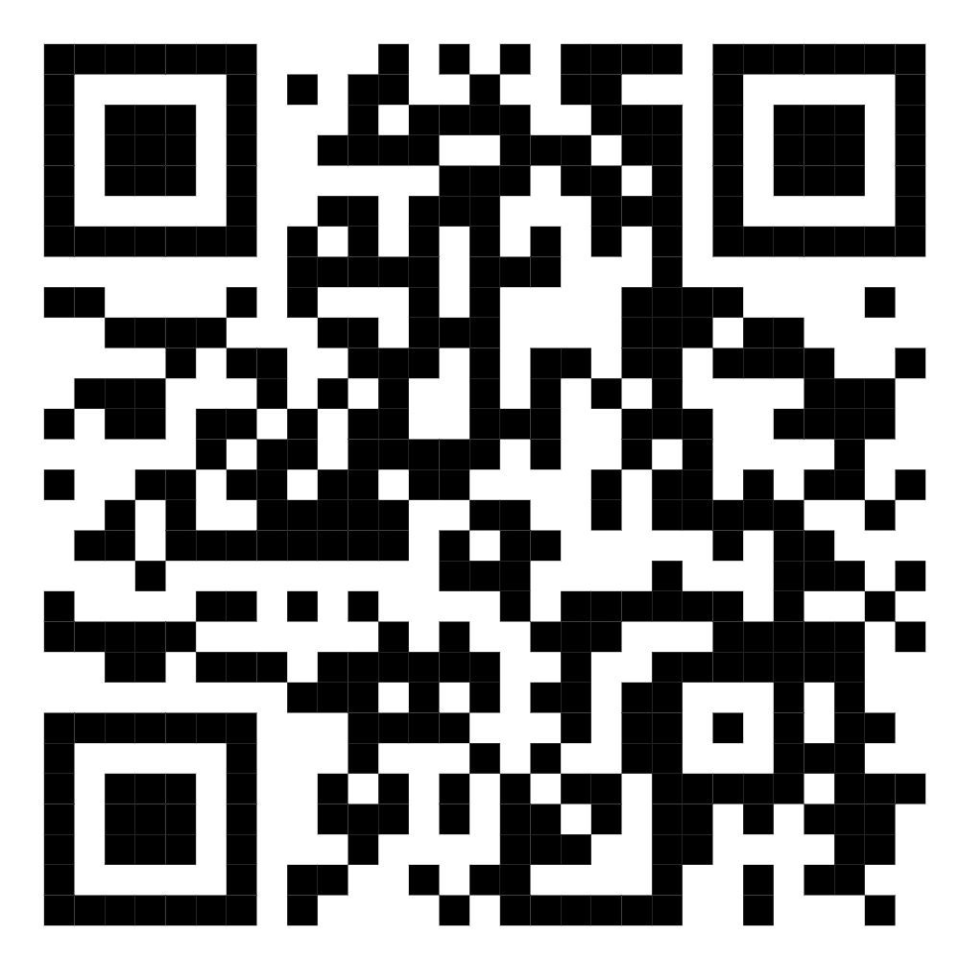



Pathway to Bath
Free online curriculum enrichment for Year 12 students
Do you meet one of the Widening Participation/ Contextual criteria?
Develop your academic skills by completing an undergraduate project on a topic that you enjoy, and join us on campus for a summer residential!
Applications are now open
and close 4 January 2026
Find out more and apply now:
www.bath.ac.uk/campaigns/pathway-to-bath-programme
# Belong at Bath

