Slide 1

Y11 PARENT INFORMATION EVENING EFFECTIVE REVISION
Achieving Excellence Together
Kindness
Achieving Excellence Together
Aspiration
Perseverance
Achieving Excellence Together

Slide 2
HOW TO REVISE: THE 20 REVISION TECHNIQUES THAT WORK
Make a plan
Create a calm study space
Prepare a folder for each subject / topic
Be clear about your goals and grades
Find out exactly how long you’ve got
Understand your gaps
Draw up a revision timetable
Test yourself
Space out your revision
Switch topics regularly
Use mind maps
Self quiz with flashcards
Use practise exam papers
Time yourself answering questions
Do some revision every day
Take regular breaks
Know your most productive time of day
Sleep well
Turn up on time
Do your best
Achieving Excellence Together

Slide 3
HOW TO USE PAST EXAM PAPERS TO REVISE EFFECTIVELY
Achieving Excellence Together
Kindness
Achieving Excellence Together
Aspiration
Perseverance
Achieving Excellence Together

Slide 4
WHY USE PAST EXAM PAPERS?
Revision is often a process of memorising facts, dates, formulas and quotes, but the best way to make sure you’ve retained that information is to test yourself on it.
By testing your knowledge you can check your revision progress and feel more confident about what you already know.
Get familiar with the types of questions
Get familiar with the types of answers
Discover useful areas of focus for revision
Practise managing your time
Practise staying focused
Achieving Excellence Together

Slide 5
THREE WAYS TO USE PAST EXAM PAPERS
TOPIC TESTS
Complete exam questions by topic
EXAM PAPERS
Complete a paper, circling what you don’t know
MARK SCHEMES
Learn the perfect answer to standard questions
Achieving Excellence Together

Slide 6
EXAM PAPERS: TOP TIPS
Follow all the instructions
Take your time reading the instructions and questions carefully
Check the number of marks awarded for each question
Ensure you have the correct equipment
Check if it is a calculator or non-calculator paper
Ensure you use pencil for drawings
Show your working and check your answers
Don’t round any numbers until your final answer
Double check your answers to check if they are reasonable
Prepare and organise your time
Familiarise yourself with the exam format, style and timing
Double check the dates and times of your exams
Achieving Excellence Together

Slide 7
HOW TO USE PAST EXAM PAPERS
Use exam board websites to find the exam papers AND mark scheme
Sit down to complete the paper under timed exam conditions
Use the mark scheme to mark your paper
Use specification list to reflect what you know and what you don’t know
Create flashcards
Aim to complete at least two past exam papers each week
Achieving Excellence Together

Slide 8
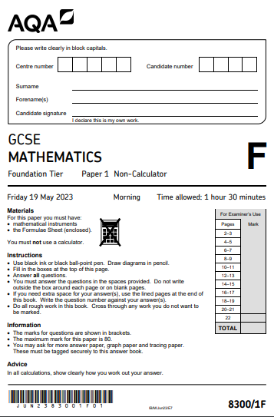
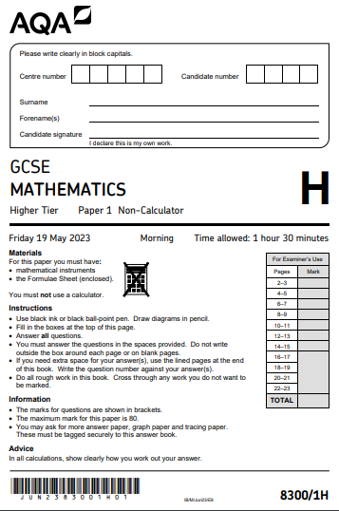
A MODEL…
Pick a past exam paper
Use this mark scheme to mark your work
Use our Sparx-Maths topic list to identify areas to practice…
Achieving Excellence Together

Slide 9
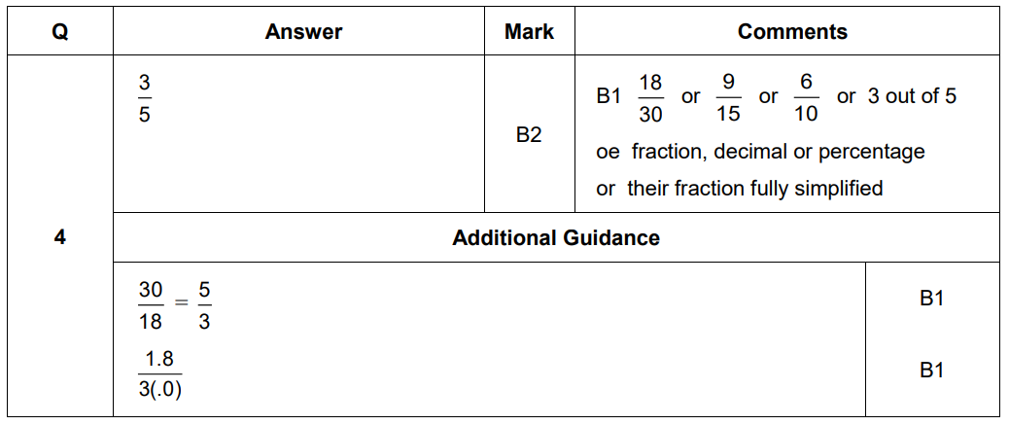
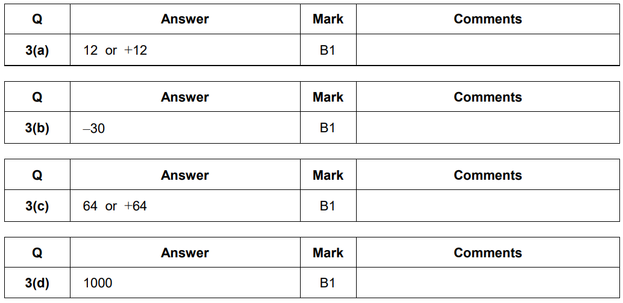
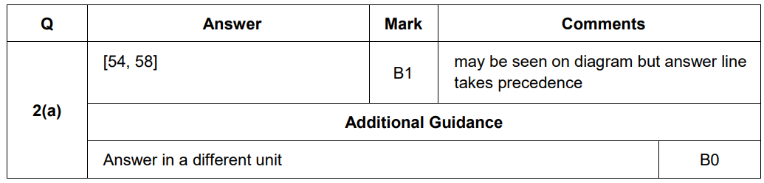
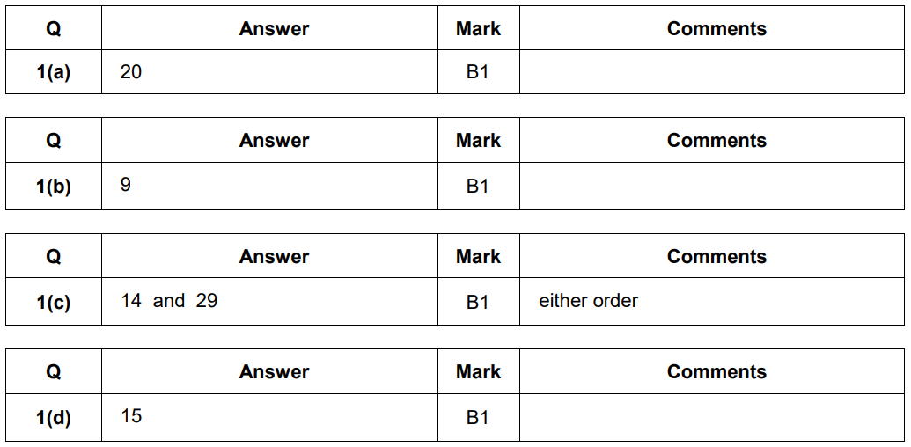
A MODEL…
Pick a past exam paper
Use this mark scheme to mark your work
Use our Sparx-Maths topic list to identify areas to practice…
F
Achieving Excellence Together

Slide 10
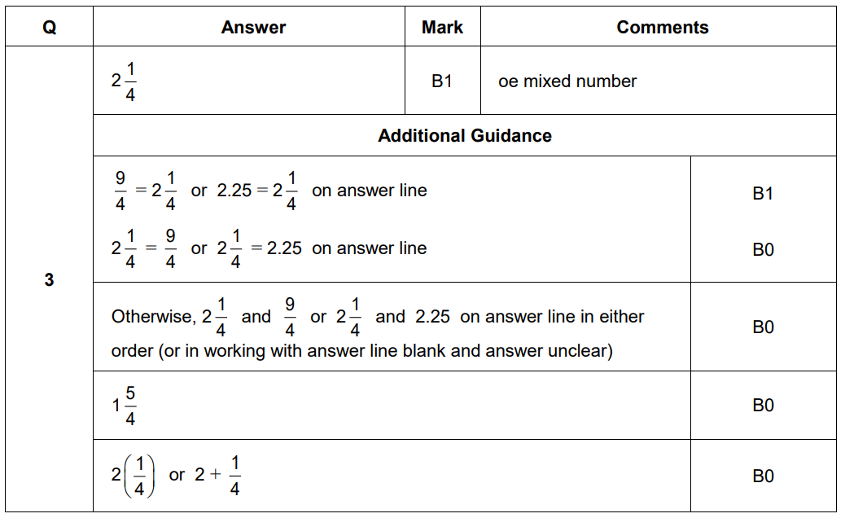
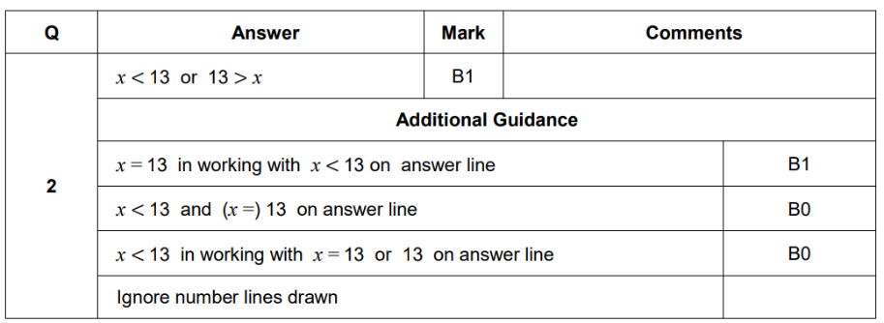
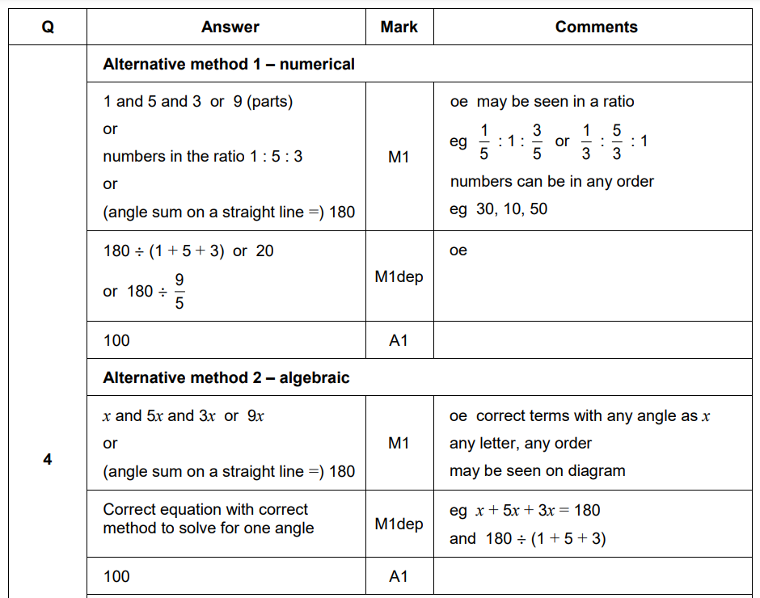
A MODEL…
Pick a past exam paper: Foundation or Higher
Use this mark scheme to mark your work
Use our Sparx-Maths topic list to identify areas to practice…
H
1(a)
1(b)
1(c)
Achieving Excellence Together

Slide 11
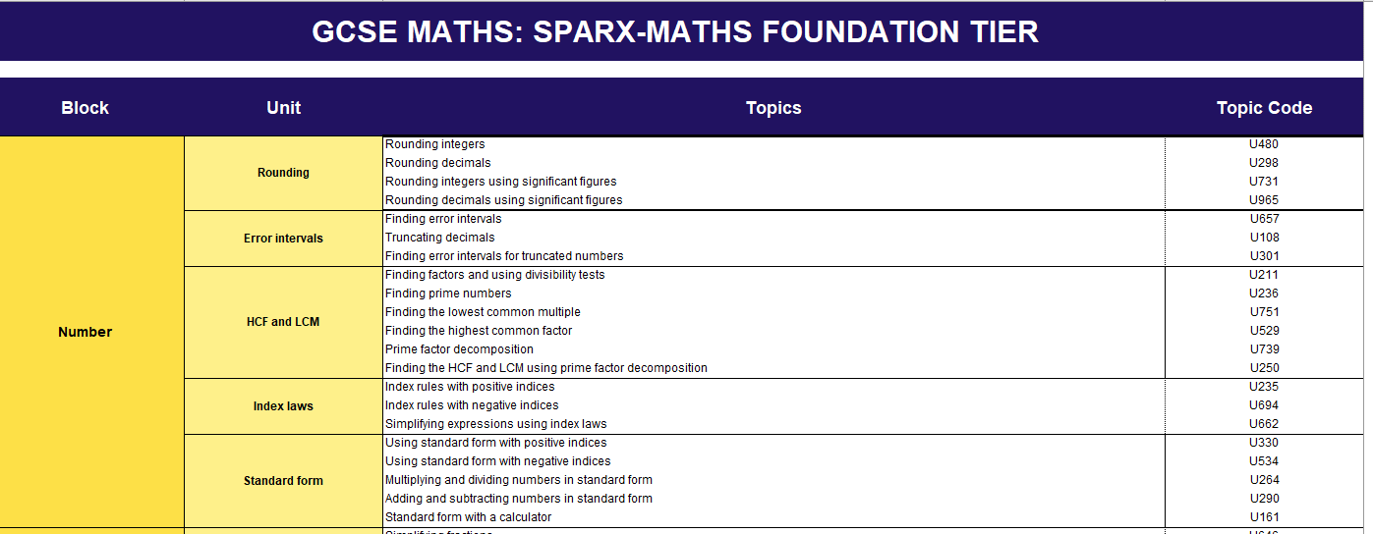
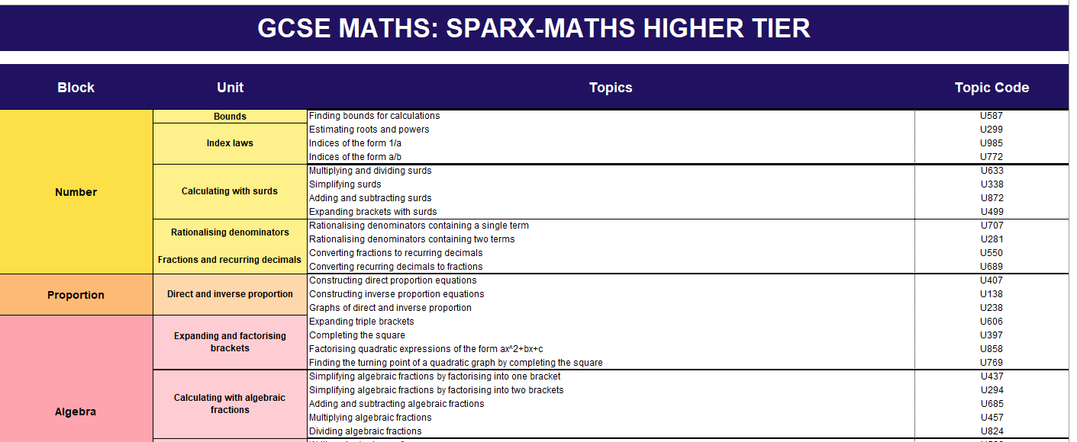
A MODEL…
Pick a past exam paper
Use this mark scheme to mark your work
Use our Sparx-Maths topic list to identify areas to practice…
Achieving Excellence Together

Slide 12
FURTHER ADVISE AND GUIDANCE
How to use past exam papers to revise effectively (The Student Room Uni Guide)
  Reasons why past papers are a great revision tool: https://youtu.be/ldCtYtobaYI
  Three different ways you can revise using past papers: https://youtu.be/eCeQcyWSZNc
  AQA command words: https://youtu.be/4RGnOSC0K6Q
  Tips to manage time in the exam: https://youtu.be/EhtsDU_hcR0
  How to use mark schemes: https://youtu.be/LxkjjU42h8s
Achieving Excellence Together

Slide 13
HOW TO REVISE FOR GCSE ENGLISH LANGUAGE PAPER2
Achieving Excellence Together
Kindness
Achieving Excellence Together
Aspiration
Perseverance
Achieving Excellence Together

Slide 14

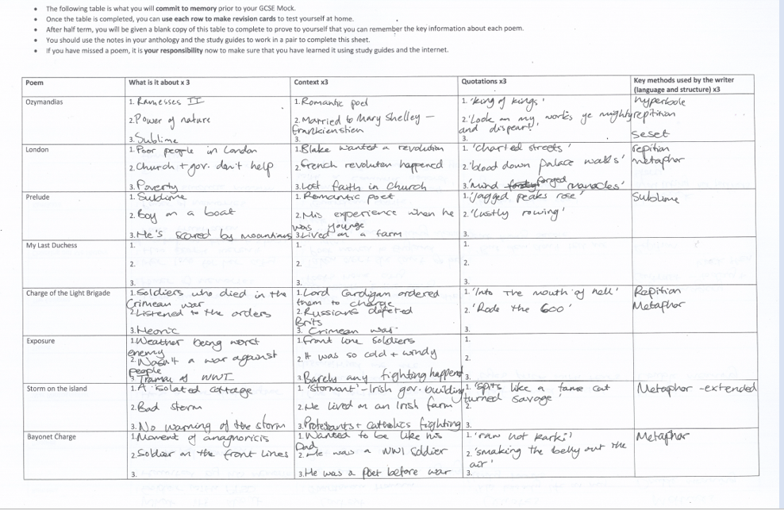

WHAT CAN WE DO TO SUPPORT AT HOME?
Check completion of Seneca home learning and revision tasks.
Encourage students to re-read GCSE texts; they have their own copies.
Study sessions on Wednesday, afterschool with English teachers.
Begin revision for mock examinations. Start early.
Use CGP guides to revise (available to purchase from the English Department).
Use revision grids and create revision cards.
Know the skills.
Complete practice questions.
Students can ask teachers for support on revision.
Achieving Excellence Together

Slide 15
WHAT CHALLENGES ARE THERE IN GCSE ENGLISH LANGUAGE EXAMS?
English Language | 100% Examination | - Split across two examinations (3 and a half hours total. - 80 marks for reading comprehension - 80 marks for writing (grammar and accuracy important)
No longer any coursework to support student grades.
Achieving Excellence Together

Slide 16
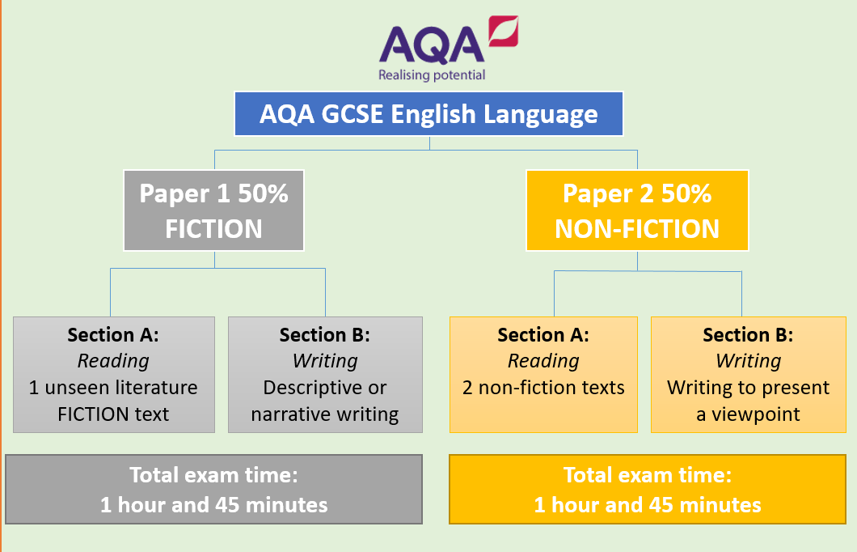
Preparing for GCSE English Language
The next mock examination is English Language Paper 2.
We are going to look at how to revise and practice Q5 (25% of the GCSE!)
Achieving Excellence Together

Slide 17
For Section B (Q5), students could be asked to write the following:
A speech (June 2023).
A letter (Nov. 2022).
An article (June 2022/ Nov. 2021).
An essay.
A leaflet.
They need to know what examples of these forms of writing look like. They need to know how to imitate them.
Achieving Excellence Together

Slide 18
MINIMUM INGREDIENTS FOR EFFECTIVE NON-FICTION WRITING
Achieving Excellence Together

Slide 19
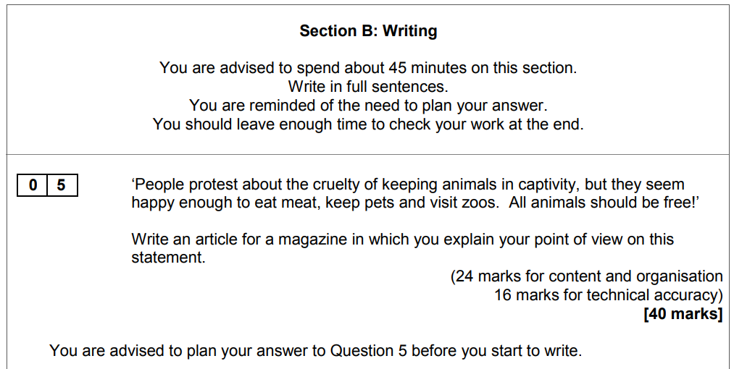
Key skills:
Sentences.
Methods.
Punctuation.
Structure.
Vocabulary.
A list of past paper questions are available here:
https://www.physicsandmathstutor.com/past-papers/gcse-english-language/aqa-paper-2/
Achieving Excellence Together

Slide 20

Key skills:
Sentences.
Methods.
Punctuation.
Structure.
Vocabulary.
Write one paragraph in response to this past paper question.
You need to demonstrate all the skills.
You have a cheat sheet to help you.
Most convincing (and the one demonstrating the most skills) wins the prize.

Slide 21
A MODEL:
Is there more we can do to prevent animal cruelty? Yes! 79% of people in Dorset eat meat every day. Without doubt, the mass production of cheap meat has a large part to play in debates around animal cruelty. Imagine this. If residents of Dorset committed to eating meat-free meals one day a week, this would result in a significant decrease in the instances of animal cruelty in abattoirs, poultry farms, and dairies. According to leading animal welfare expert Dr Peter Jones, “this simple act of sacrifice would lead to a change in approach to how we view animal welfare within the agricultural sector”. The answer is not to preach veganism; the answer is not to ban burgers! But, if we make small changes to the way we think about what we eat and how often we eat it, this could go a long way, ensuring that our tasty chickens have lived better lives.
Achieving Excellence Together

Slide 22
HOW TO USE FLASHCARDS EFFECTIVELY?
Achieving Excellence Together
Kindness
Achieving Excellence Together
Aspiration
Perseverance
Achieving Excellence Together

Slide 23

Effective use of flashcards
Only one question per card
Use images and colours
Use acronyms and mnemonics
Group by topic
Use flashcards to test yourself
Make your flashcards digital
Use the Leitner system
Achieving Excellence Together

Slide 24
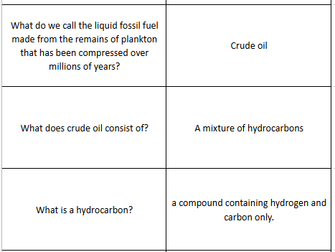
Achieving Excellence Together

Slide 25
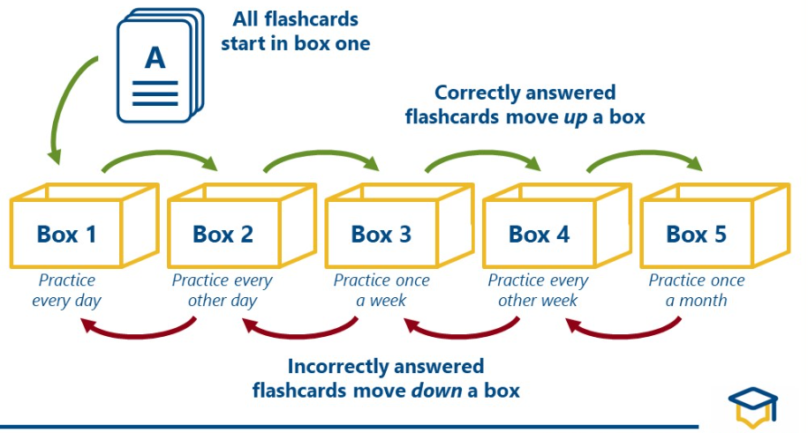
Leitner system
Achieving Excellence Together

Slide 26
Revision card games
Take a card from the bag and describe the word to the rest of the team.
When correct, put to one side and describe the next one.
Continue until the timer is up.
Pass the bag to the next player and repeat.
When everyone has had a turn(s), count the correct cards – team with most cards wins!
Achieving Excellence Together

Slide 27
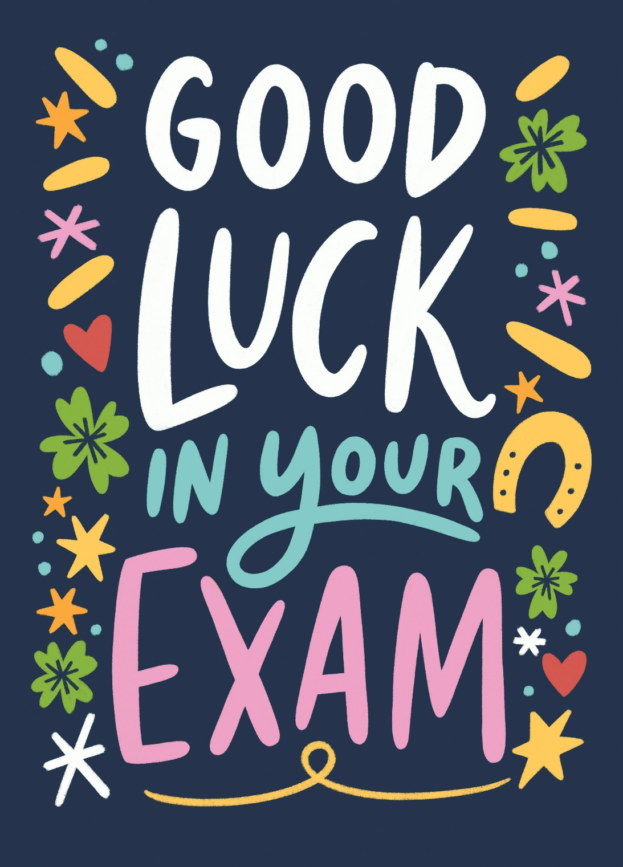
Achieving Excellence Together

